Slide 1
Campus Rover
CS 119a
Brandeis University
Fall 2018, Pito Salas, Alexander Feldman

Slide 2
Sensors
Lidar
Depth Camera
Turtlebot sensors:
RGB + Depth camera
Bump sensors
Dropped wheel sensors
Inertial measurement unit
Package sensor

Slide 3
Actuators
Locomotive
Turtlebot actuators:
Motorized wheels
Speaker
Manipulative

Slide 4
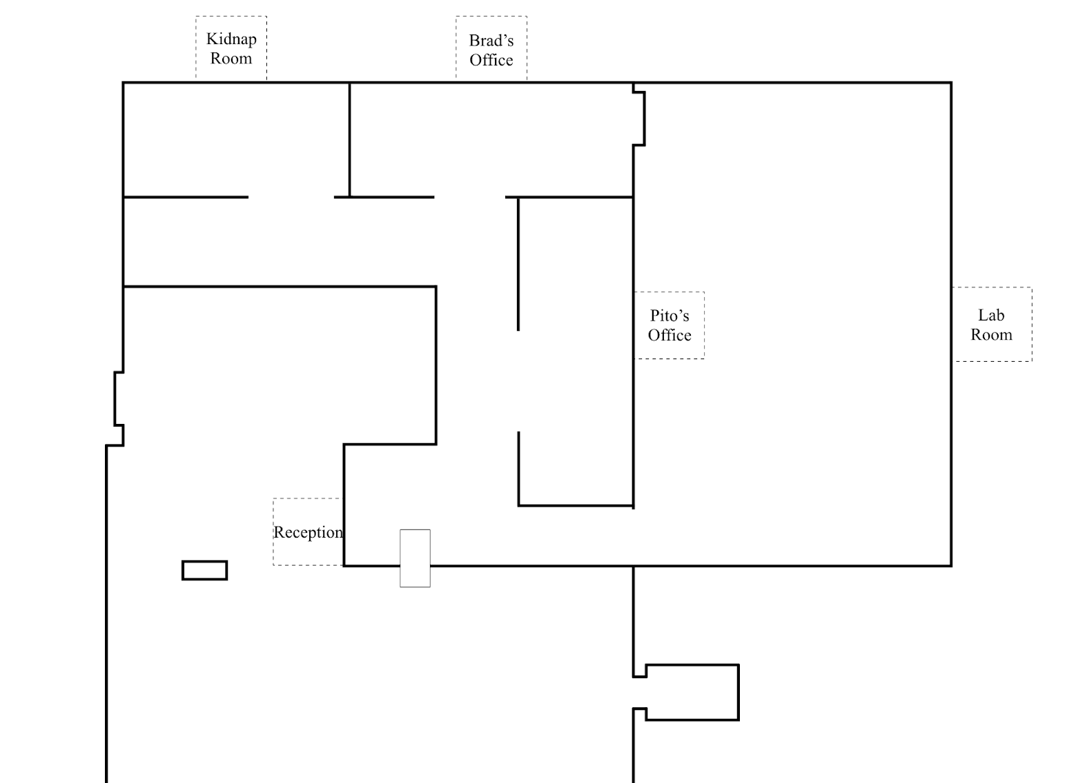
Localization
Real robots don’t drive straight
AMCL Adaptive Monte Carlo Localization
Fiducials

Slide 5
ROS
Middleware between Python and Ubuntu
Distributed architecture
Message passing between nodes

Slide 6
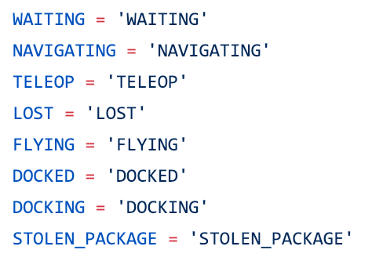
What is the robot doing?
States
Logging
Visualization

Slide 7
Flask server
Package handler
User Interfaces
Destination handler
Teleop
Input handlers
State manager
Lost recovery behavior
Robot internals
Navigation planner
AMCL localization
Fiducial recognition
Task handling
Physical Interfaces
Raw sensor processing
Motor controllers

